Slide 1
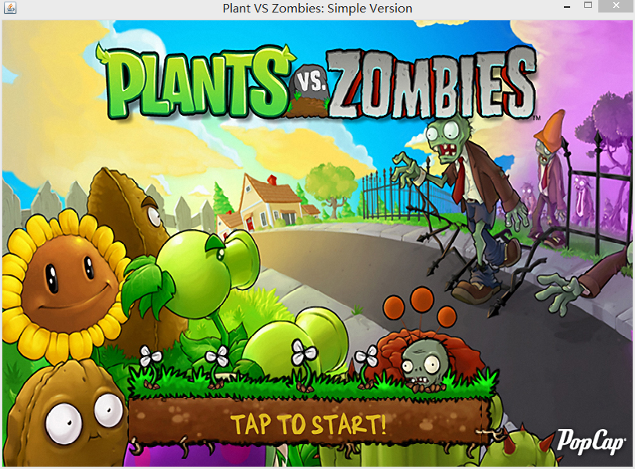
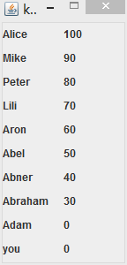
When you click PVZ.jar, you will see the screen (like the picture showed). At the right cornel, you can see a rank list where shows player’s information.

Slide 2
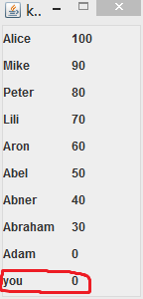
At the beginning of the game, you can see “you” on kill rank. This “you” is referent to you
At the beginning of the game, the kill number is zero so that the number on the right is “0”

Slide 3
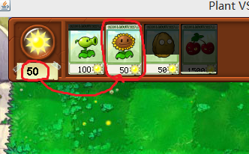
You have 50 sunlight at beginning (which is circle out in the image). You can use these sunlight to buy plant
In each card, you can the type of the plant from it’s image and the cost of the plant which is shown at the button of the plant.

Slide 4
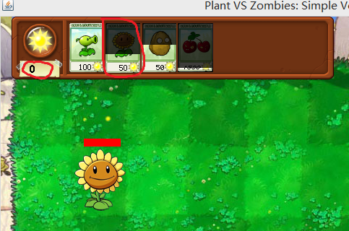


figure 1
figure 3
figure 2
When the card is bright (see figure 1), this mean the plant is ready for sell. You can buy it and plant it at the green field (see figure 2)
If you do these successfully, the card will enter into loading state (see figure 3). When it load over, it be bright again (see figure 1). This means you can buy it again.

Slide 5
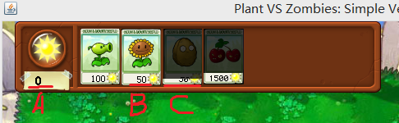
If you don’t have enough sunlight( A in the figure ) when you want to buy a sunflower ( B in the figure ), the program will give you a beep sound as warning.
Also if a card isn’t bright ( C in the figure ). You can not buy it either. You need to wait until it loading over.

Slide 6
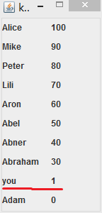
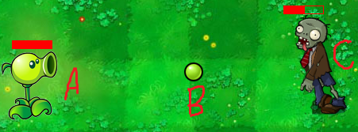
figure 2
figure 1
figure 3
Pea Shooter( A in the figure 2) can emit a bullet ( B in the figure 2). If bullet hit zombie (C in the figure 2), zombie will lose some health point.
if zombie’s health bar is empty. He will die and you get 1 kill number which will show in kill rank.
(see figure 1 and figure 3)

Slide 7
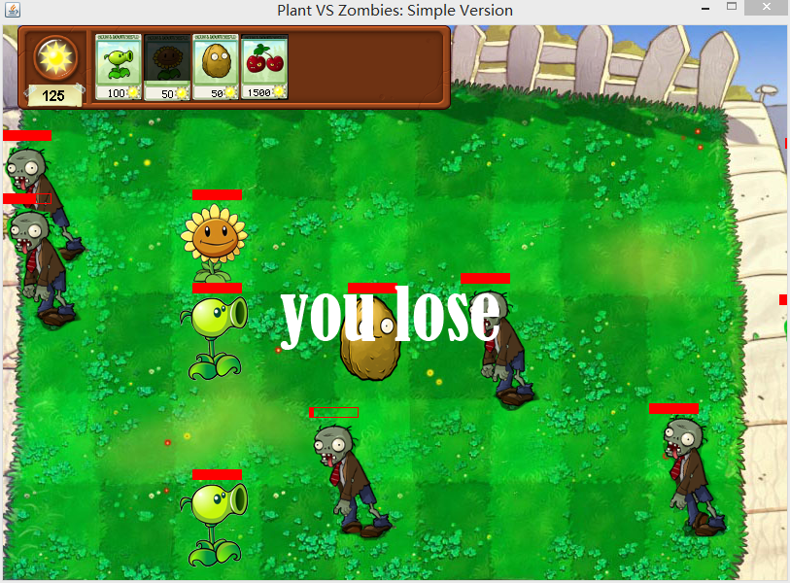
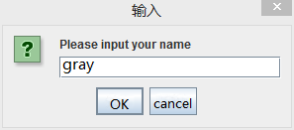
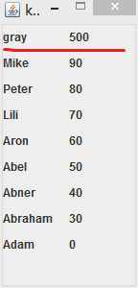
And program will ask you to input you name. If you have more kill number than any one on the kill rank, the program will save you name and kill number and show them on the kill rank
With time goes by, there will be more and more zombies. If any of them reach to the left side of the screen, the game over.

Slide 8








Cherry will explode in a short time and kill all the zombies on the screen.
Sun flower will produce sunlight for you. Each time it become bright, you will earn 25 sunlight
600<Health
400<Health<600
Health<400
Pea shooter will emit bullet to attach zombies.
Nut Wall has high health point. It can be used as a wall to restrict zombies

Slide 9




Zombies: use these four image to imitate their moving
If any zombies reach to the left side of the screen, the game over.

Slide 10
FAQ
Q: how to win this game?
A: The purpose if this game is try you best to kill as many
zombie as possible. This mean there is no win strictly
speaking.
Q: I typed my name but it was not show in the kill rank
A: Only the player who has high kill number will be shown in
the kill rank board. This means you need to have more
kill number than any one of them who is already on the
rank list.

Slide 11
Citation
All the images come from a game call “Plant VS Zombies.” PopCap Games. 5 May 2009. Access date 4 June 2017.

